Slide 1



Data Structure
&
Algorithm
Class VIII
lab 11

Slide 2


Parentheses
A parenthesis is a tall, curvy punctuation mark used to set off material that isn't fundamental to the main topic

Slide 3
Balanced Parentheses
each opening symbol has a corresponding closing symbol and the pairs of parentheses are properly nested
(()()()()) (((()))) (()((())()))

Slide 4
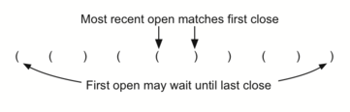
Clue for solving stacks

Slide 5
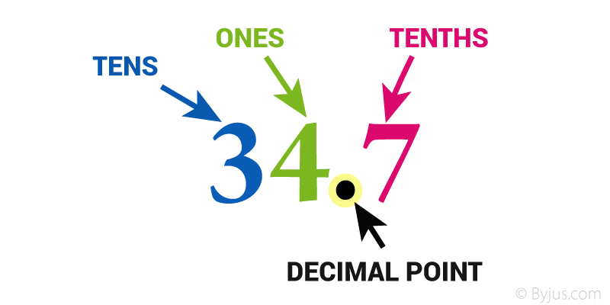
Decimal Numbers
positional numeral
system employing
10 as the base and
requiring 10 different
numerals

Slide 6
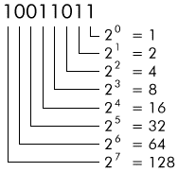
Binary Numbers
a number expressed in the base-2 numeral system

Slide 7
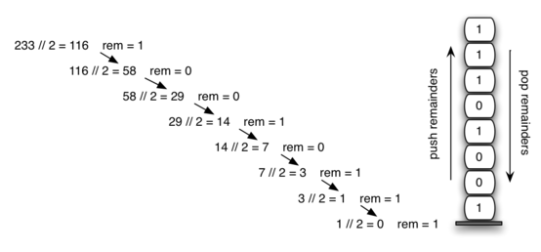
Decimal to Binary

Slide 8
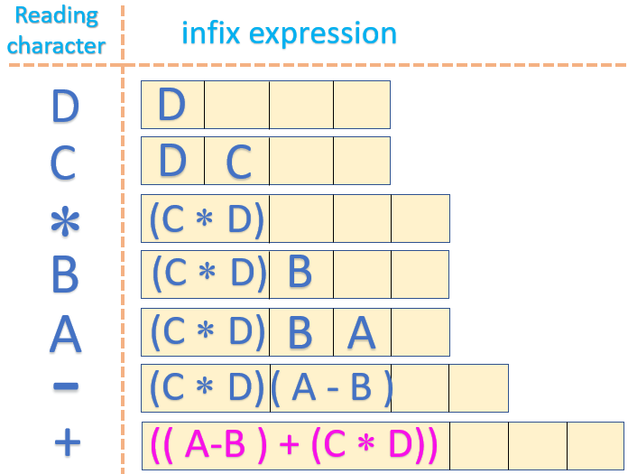
Infix

Slide 9
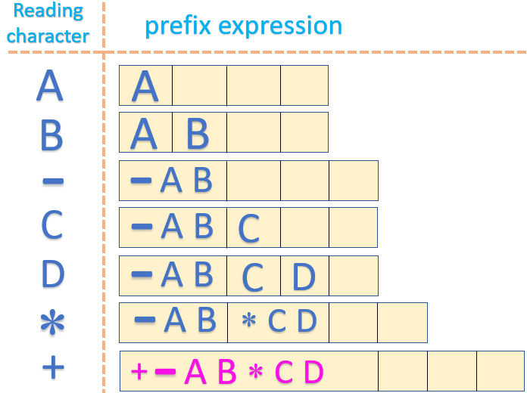
Prefix

Slide 10
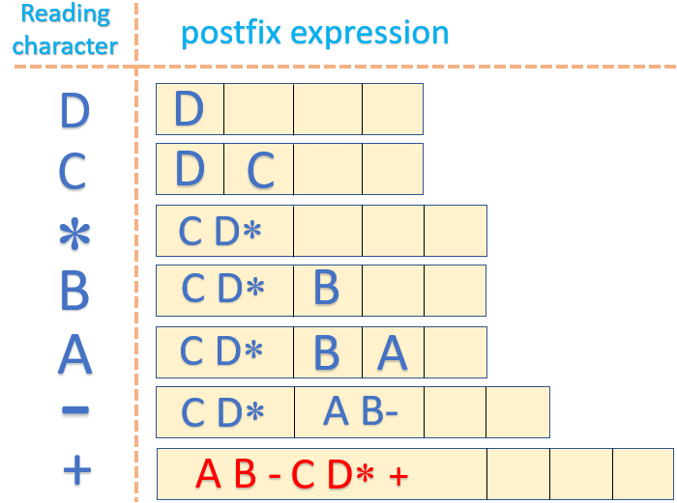
Postfix

Slide 11


